Slide 1
CollageParsing: Nonparametric scene parsing by adaptive overlapping windows
Frederick Tung and James J. Little
ECCV, 2014

Slide 2
Outline
Introduction
Related Work
Proposed Method
Experimental Results
Conclusions

Slide 3
Introduction
Scene parsing
Assign a semantic label to every pixel
State-of-the-art
Match superpixels
Good at large regions of background
Less well on object
Object class
Superpixel features are not very discriminative
Combine heuristically (HOG, SIFT)
Superpixels tend to fragment objects
Apply auxiliary techniques to combine
Local context, label co-occurrence

Slide 4
Introduction
Proposed method: Collage Parsing
Mid-level (content-adaptive window)
Instead of low-level superpixels
Capture entire objects (not fragment)
Surrounding contextual information

Slide 5
Related Work
Parametric
A small advantage in accuracy
Train some models to classify each pixel
Nonparametric
No training time
Handle dynamic datasets
3 steps
Scene retrieval
Region matching
Label transfer

Slide 6
Related Work
Auxiliary method
Spatial context
Global / local context information
Geometry cue
Horizon
“Object” class
Exemplar-SVMs
Rare class expansion

Slide 7
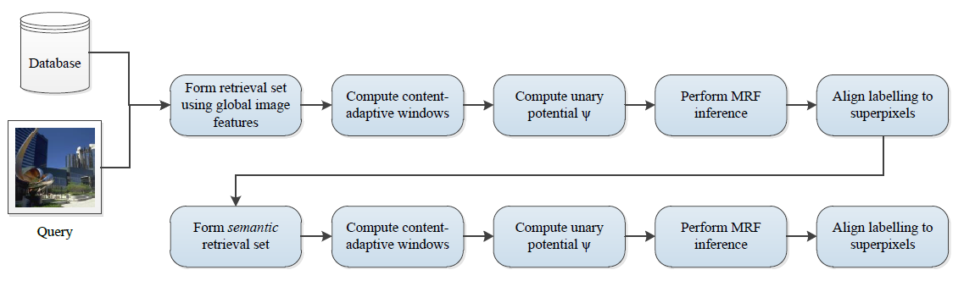
Proposed Method
Overview

Slide 8
Forming the retrieval set
The retrieval set
Find a subset of database images
Contextually similar to the query images
Compare the query and database images
Use Gist, HOG feature
Select the top K images

Slide 9
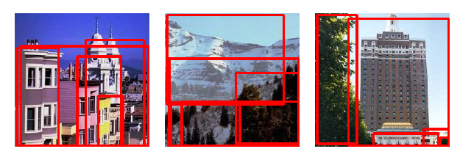
Computing Context-adaptive Windows
Objectness measure [1]
Image windows with high “objectness”
Any object window prediction can also be used
Windows feature
HOG feature

Slide 10
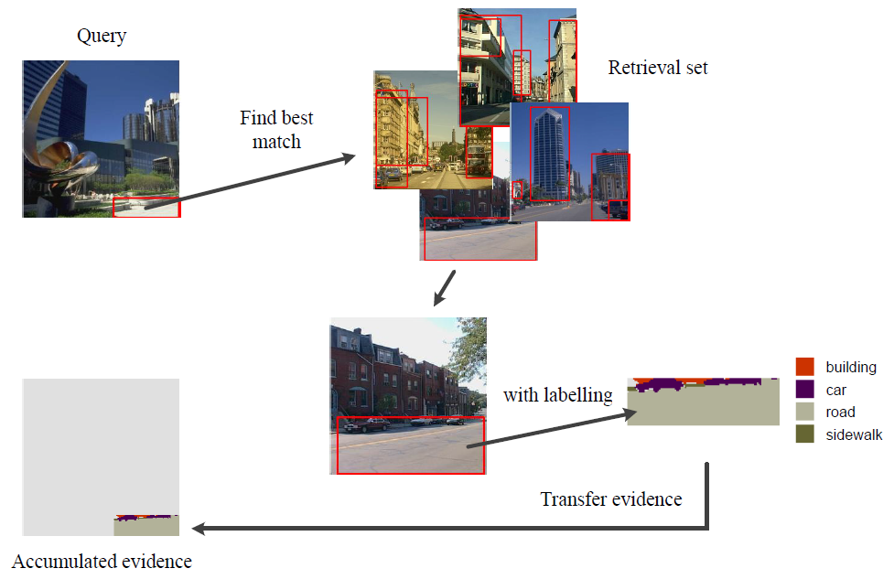
Computing Unary Potentials
Transfer the labels
From the most similar windows in the retrieval set

Slide 11
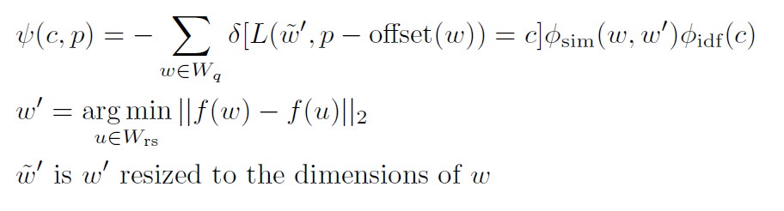

Computing Unary Potentials
$ψ(c,p)$: unary potential
The cost of assigning a label of category c to pixel p
$w$ : object window (query image)
$w^{′}$ : the most similar window (retrieval images)
$φ_{idf}(c)$ : the penalty of frequency categories

Slide 12
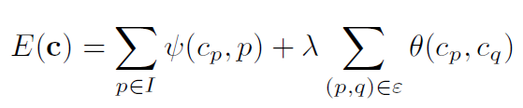
Performing MRF Inference
MRF energy function
Unary potential
Label co-occurrence statistics

Slide 13
Align Labeling
Refine label region
To improve the alignment of the labelling
Superpixels in the query image share the same label
Assigned the most common label in the superpixels

Slide 14
Retrieving Semantic Neighbors
First retrieval
Global image feature
Second retrieval (semantically similar)
Ranked by pixel-by-pixel labelling
First retrieval
second retrieval

Slide 15
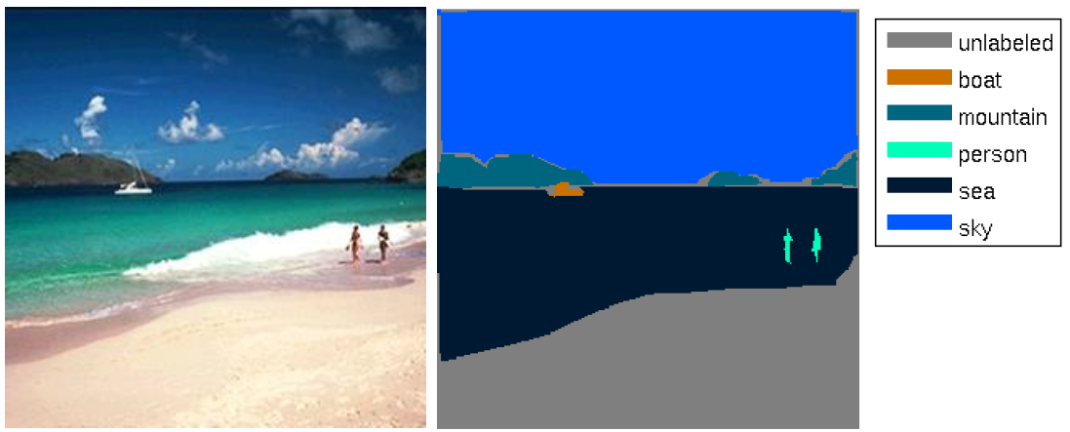

Experimental Results
SIFTflow dataset
2488 training, 200 testing image
33 classes
Image size 256$×$256

Slide 16
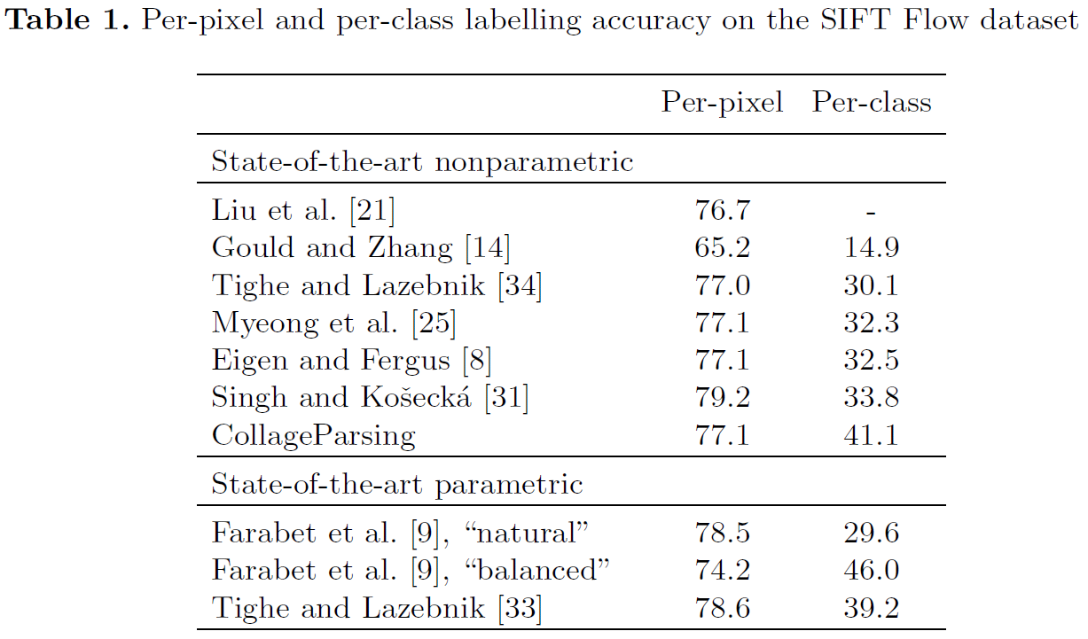
Experimental Results
Sift Flow dataset

Slide 17
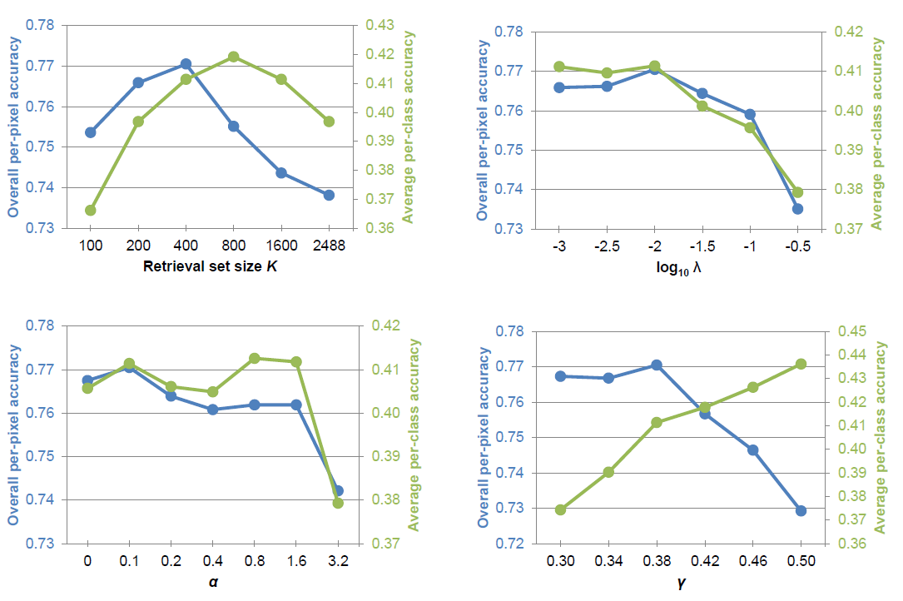
Experimental Results
Parameters

Slide 18
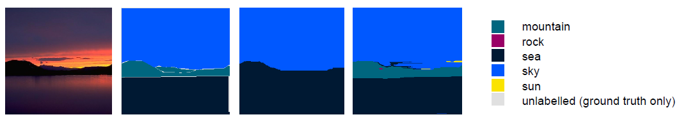
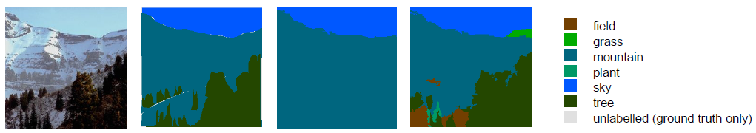
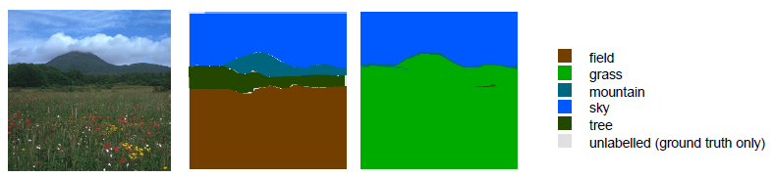
Experimental Results

Slide 19
Conclusions
Nonparametric scene parsing
Mid-level, content-adaptive windows
7 to 11% higher average per-class accuracy
Future work
Add other relevant image inference
Ex: geometric inference

